Slide 1


SMART Garden Automated Indoor Gardening System
Final Presentation
Group 34
Ryan Hassan [CPE]
Kevin Lorch [CPE]
Lauren Melancon [EE]
Jonathan Wallhauser [CPE]

Slide 2


Introduction
The SMART GARDEN is an automated indoor gardening system which provides accurate sustainment of a variety of plants with help of a dynamic database.
Notes:
So, what exactly is the SMART Garden? Simply put, the SMART Garden is our rendition of an automated indoor gardening system. The SMART Garden provides care and helps stimulate growth of a variety of different plants which are chosen from the SMART Gardens dynamic plant library.

Slide 3

Motivation
Inflation on the Rise
In 2022, inflation was up 6.5%. This add onto the previous 7.1% the year before.
Supply Chain Struggles
According to Morning Consult's latest U.S. Supply Chains & Inflation report, over half (51%) of consumers surveyed in March 2022 reported experiencing product shortages of specific types of groceries and food, up from 43% in September 2021.
Maximized Usability for the Everyday Person
With the popular of plant ownership and gardening on the rise, the engineers were motivated to provide a way for the everyday end user to maximize their positive results with an easy to use SMART Garden system.
Notes:
Where did the motivation come from?
Our Motivation was driven by three main points.
The FIRST being INFLATION. Did you know that in 2022 alone, inflation was up over 6%? This adds to the 2021 total of over 77 percent the year before.
The second main point of motivation behind the smart garden is the everyday supply chain struggles the United states faces to-date. According to a study from the Morning consults supply chain report -- over half of constumers in the market have reported experiencing some type of shortage in the grocery store. Whether that be eggs, milk, or their favorite veggie, the consumer is having a harder time than ever finding the goods they want.
The final main point of motivation is simple. Maximizing access to the everyday consumer. Plant ownership and hobbyist gardening is on the rise. This invigorated us to provide a reliable and fun way to keep plants in the everyday household without the downfalls of garden owenership

Slide 4

Key Goals
Create
Create a webapp that displays sensor data and details.
Concatenate
Concatenate Wi-Fi communication between the webapp and SMART Garden Dynamically Database (SGDD) to provide different sustainment operations.
Maintain
Maintain system and plant integrity through the end of its life
Sustain
Sustain water and nutrient requirements on common household plants.
Notes:
The SMART Garden objective and Goals:
First, we have the main objective of creating an Automated, dynamic gardening system
Secondly, the SMART Garden will automate house plant care
The SMART Garden will include a web application that displays areas of interest and stat lines for the end-user
Next, our SMART Garden is set to maintain and help provide growth to the plant in the housing through the end of its life.
AND Finally, the SMART Garden will be a scalable system. Meaning, there can be a single unit or many units and they will still all provide and maintain the rest of the roles and objectives put in place.

Slide 5
SMART Garden Requirements and Specifications
Requirement | Specification
Accurate Soil Moisture Readings | Averaged readings from 3 sensors
Accurate Temperature Readings | +/- 0.5 Degrees Fahrenheit
Accurate Humidity Levels | +/- 0.5%
Portable Design | Length – 18 in. Width – 10 in. Height – 8 in.
Dual Pump | <70 L/Hr pump rate
Wireless Communication to Webapp | WiFi Connectivity - 2.4 GHz ISM
Weather Sealed | IP01 Baseline Water Resistance
Relocatable | Less than 10 pounds

Slide 6
Project Approach
R&D
Research and Order Required Components
Design
Design PCB
Develop
Develop Hardware Prototype
Develop
Develop Software Prototype
Polish
Polish Design
Fabricate
Fabricate Final Product
Notes:
So, here we have structured a general outline for our plan of aattack throughout this process.
First was the Research and Design phase of the project
Following that we implemented aand dsigned our PCB
Then we began to develop a hardware prototype
Next was our software prototype
From this points we plan to polish the design of the SMART Garden and then of course fabricate and push the final product

Slide 7
Project Constraints
Cost
Cost of building the SMART Garden must fall within the project budget.
Water
Water based project requires thoughtful layout of electrical components.
Meet
Project must meet all standard engineering ethics.
Have
SMART Garden must have internet connectivity via wireless communications.
Size
Size of the housing must be taken into consideration.

Slide 8
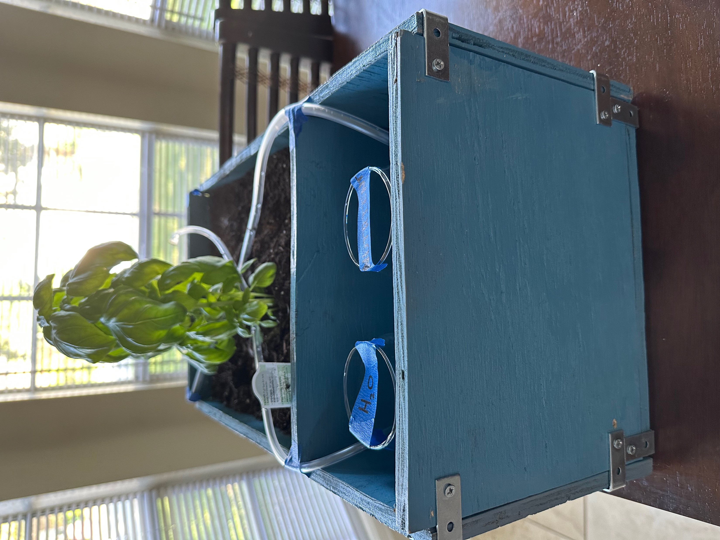
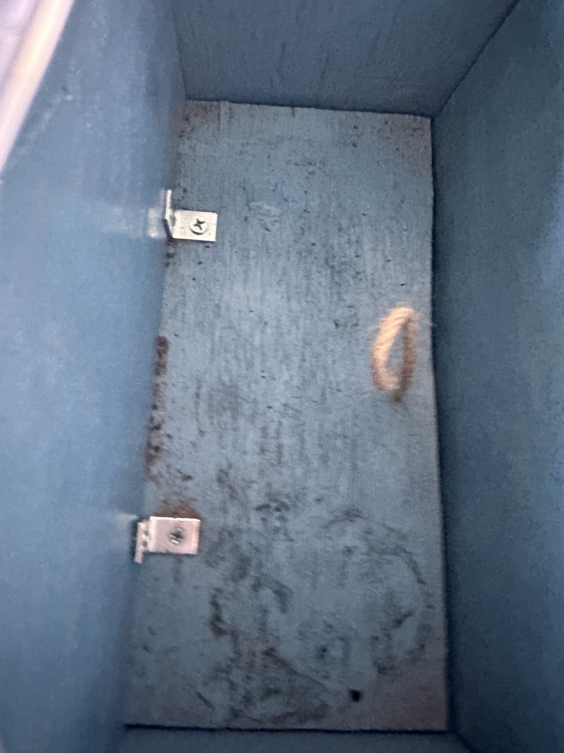
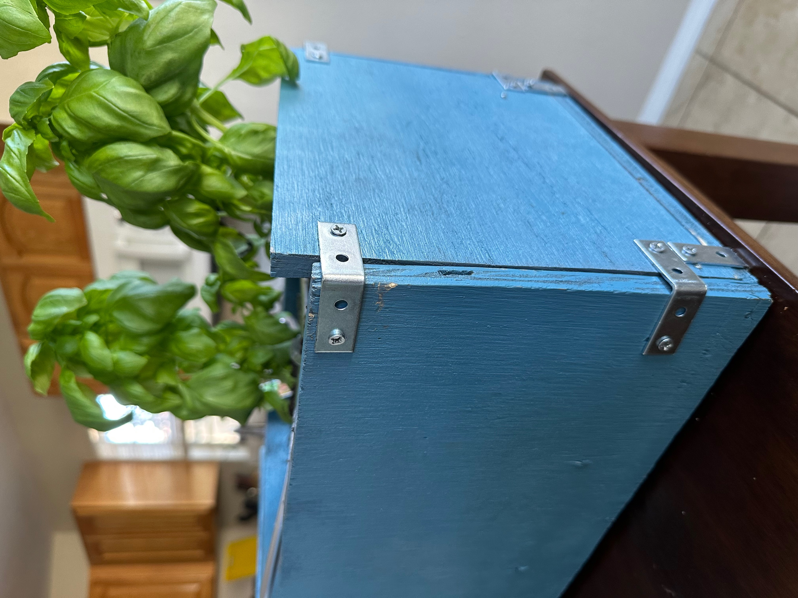
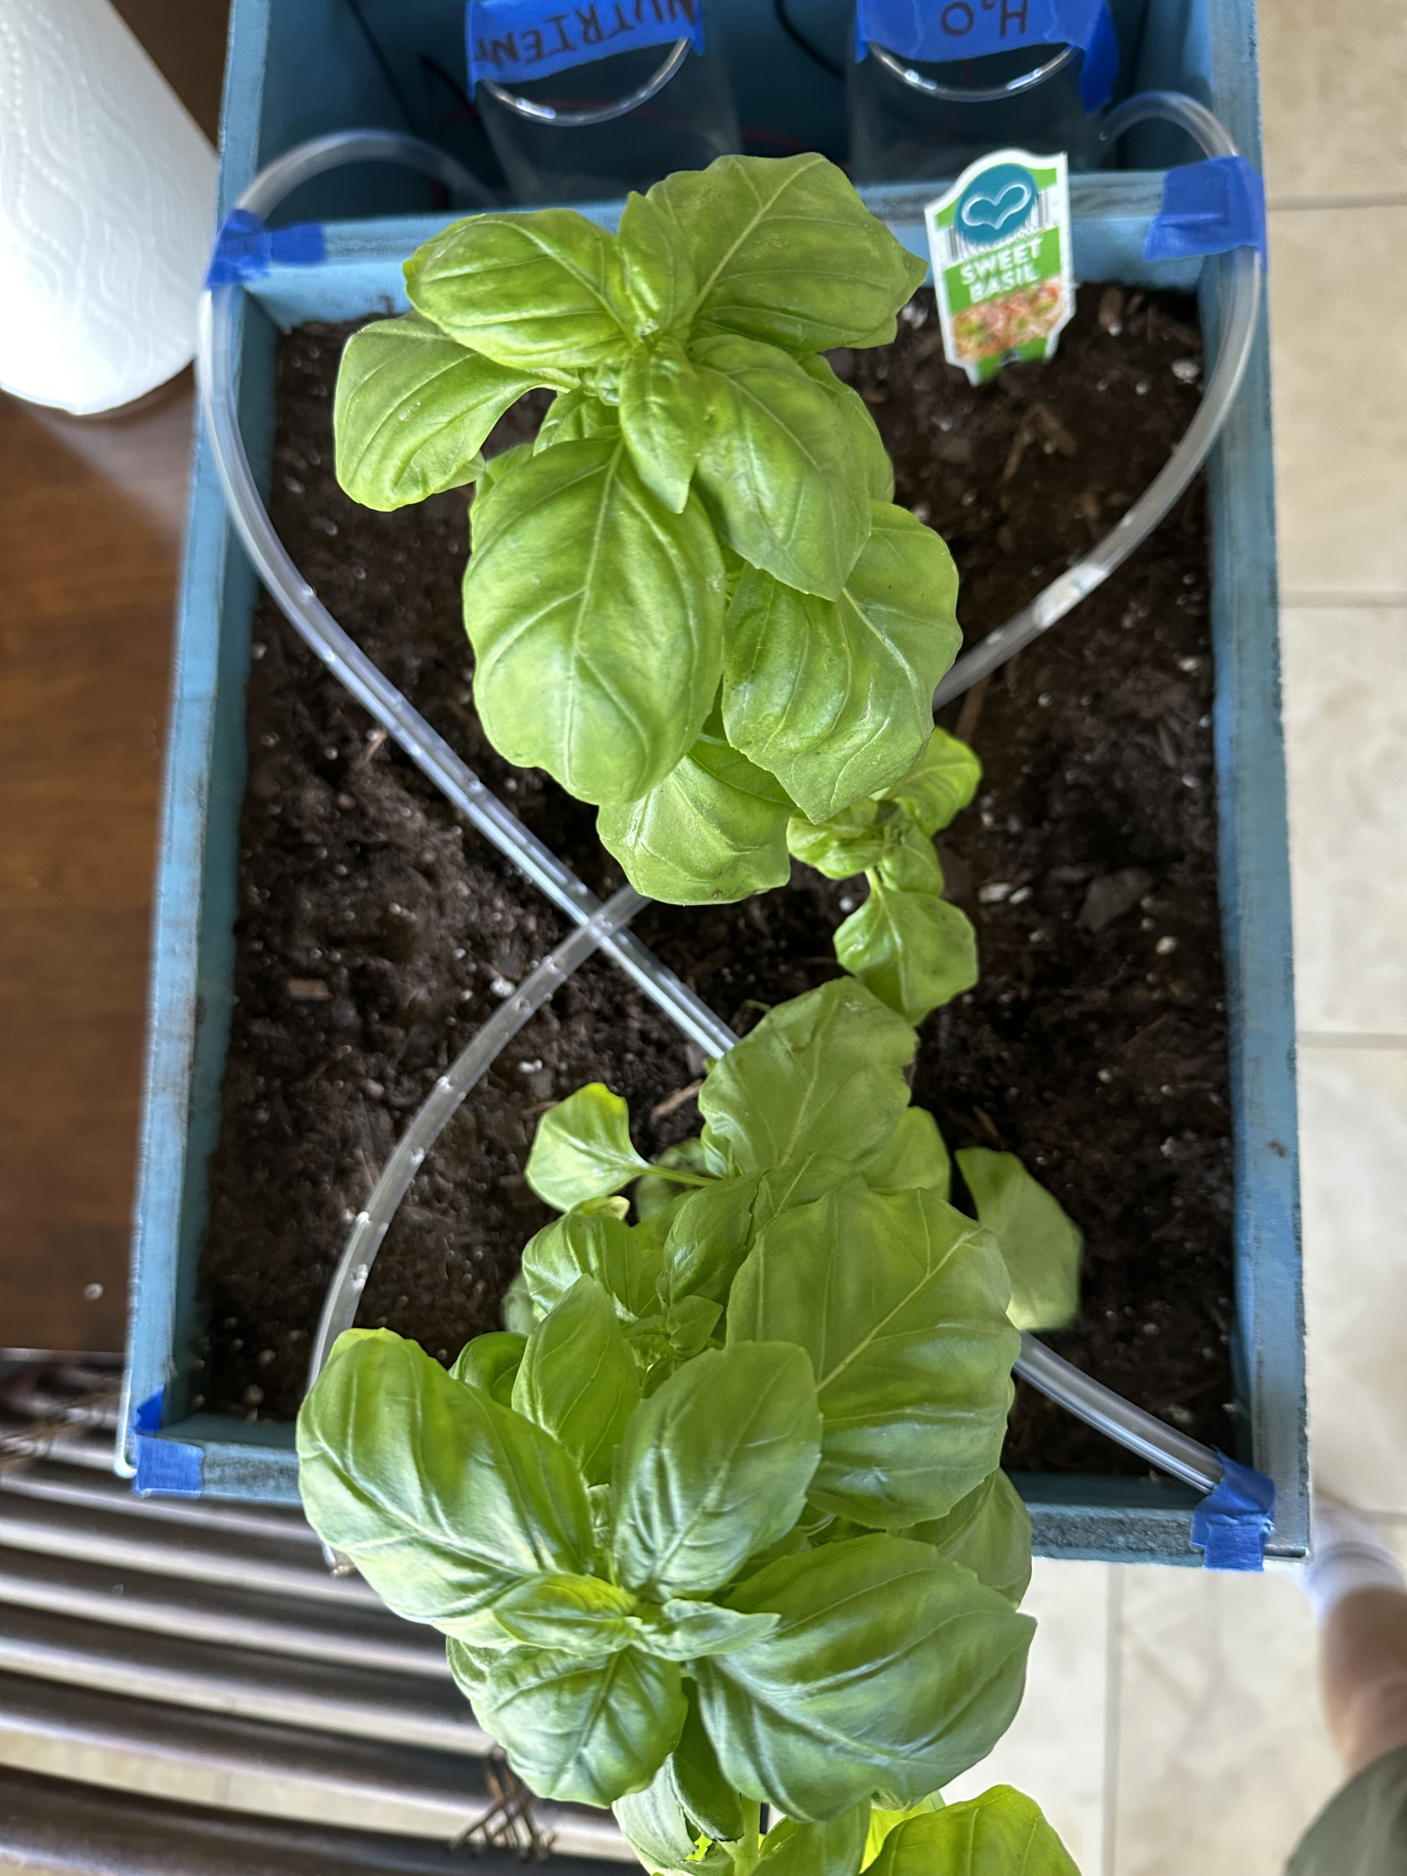
Physical Build Overview
IP01 Waterproof Rating
Secured from the outside in
Removable Drip tray beneath the upper 6-inch compartment
Reinforced bottom corners for maximized durability

Slide 9
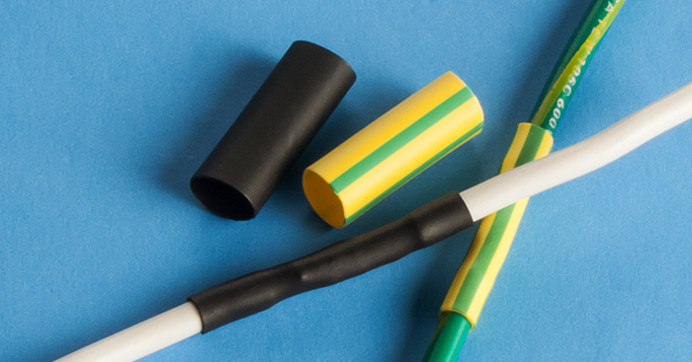
Waterproofing to IP01 Standards
The SMART Garden needs to be waterproof to both keep water in the soil and to protect the wiring between our components.
Basin – water-resistant paint protects the wood we used to construct our garden’s frame.
Circuitry – The team kept all critical electrical components separate from the housing to prevent damage.
Drip Tray -- The housing is a two-tiered system. The top tier consists of all normal components while the bottom houses a removable drip tray which catches excess water
Notes:
Basin: It is important that we use water-resistant paint so that it doesn’t degrade and get into the soil. If we get paint in the soil, we would be compromising the health of the plant, the user, or both.
Circuitry: Heat-shrink tubing shrinks when heated to form a tight seal around the wires wherever they may be vulnerable. Waterproofing spray is a coating over any component that protects the surface of the circuit board from getting accidentally short-circuited by the presence of moisture.

Slide 10
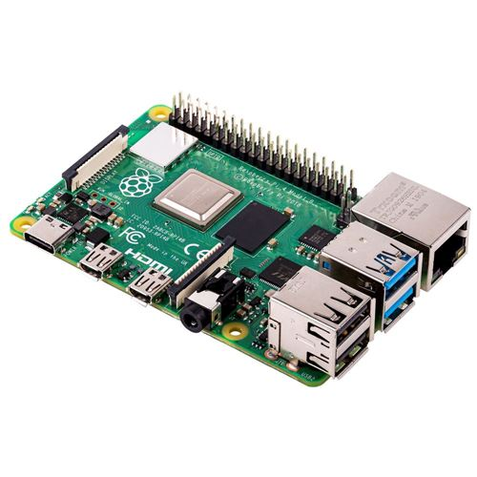
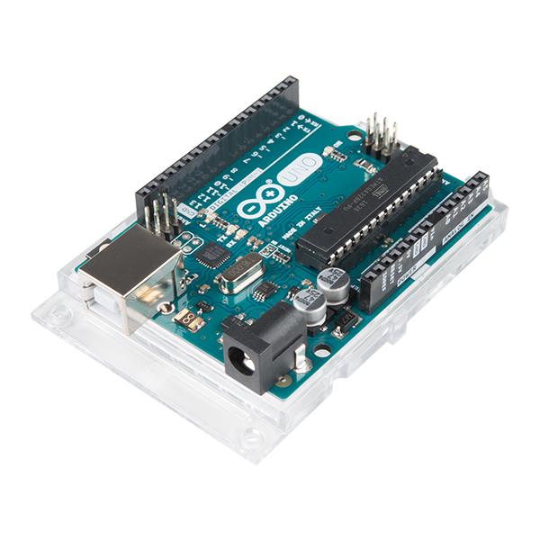

Development board Comparison and Selection
Arduino Uno
Raspberry Pi

Slide 11
Arduino Uno
Development board
16MHz processor
No ports, but achievable though shield use

Slide 12
Raspberry Pi
Single board computer
1.5GHz processor
Multiple ports

Slide 13
The Arduino Uno was selected

Slide 14
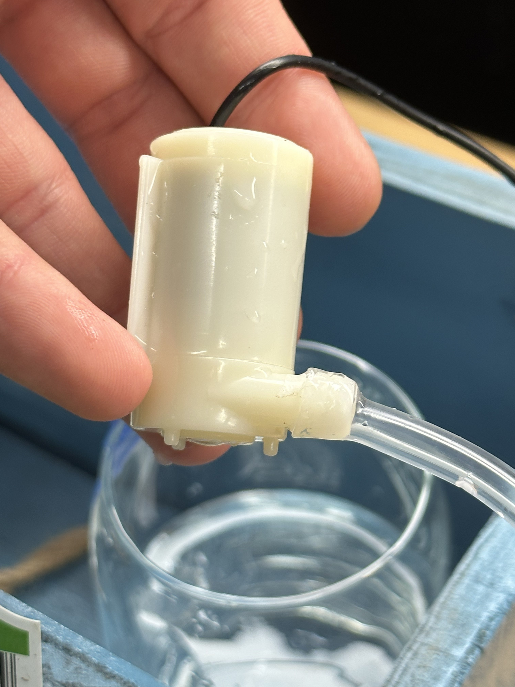
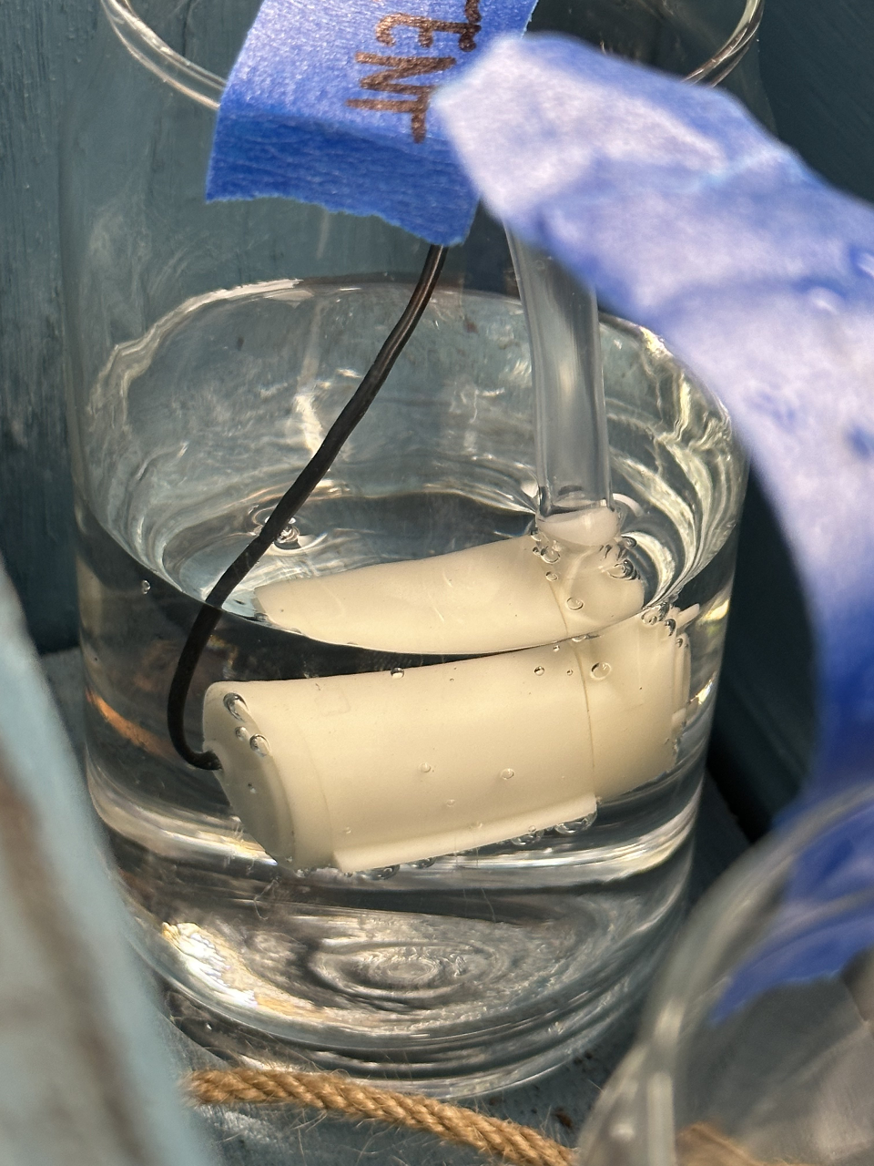
Tube Attachment Process

Slide 15
Lauren's Section

Slide 16

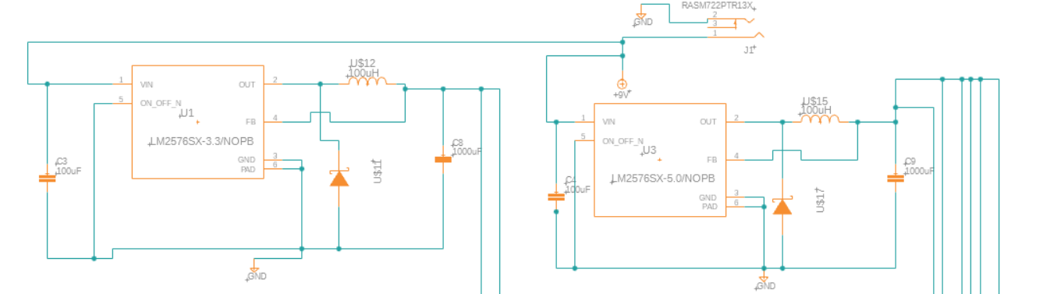
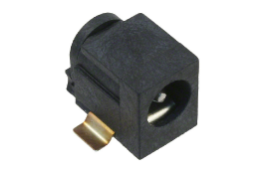
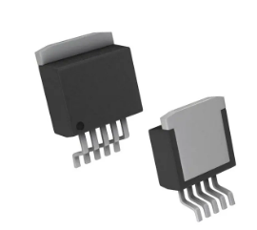
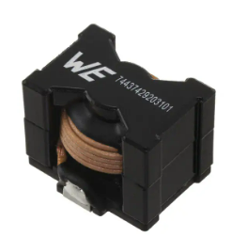
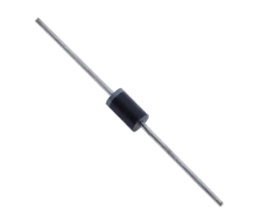
Power Schematic
9V 2A AC/DC Converter
Connected via DC power jack to PCB
LM2576-5V/NOPB Voltage Regulator
Step down 9V supply voltage to 5V
Diode: 1N5822
Inductor: 100uH
Capacitor: 100uF, 1000uF
Output Current: 3A
LM2576-3.3/NOPB Buck Converter
Step down 9V supply voltage to 3.3V
Diode: 1N5822
Inductor: 100uH
Capacitor: 100uF, 1000uF
Output Current: 3A
Notes:
In this slide we will be reviewing the power supply schematic for our SMART Garden.
The first thing we will be discussing is our power supply. Our original design called for the use of 2 9V Lithium Ion Rechargeable Batteries, which were going to be used when the design was tailored for both indoor and outdoor use.
Although, due to the fact we changed our design to be for indoor use only, and the 9V batteries had a very low current capacity, we decided to change to a 9V 1 amp AC/DC Converter that can be plugged into any wall outlet
Next we will discuss the voltage regulators. Our original choice for the 5V regulator was the 7805, although, after discussion, due to its known inefficienies we decided to opt for the more recent LM2576 family of voltage regulators. Both of these circuits utilized a 100uH inductur with a 8.8A current rating, a 100uF capacitor, a 1000uF capacitor, and the 1N5822 schotkey diode and have an output current of 3A which is more than enough available current to run all remaining hardware compnents to incldue 3 soil moisture sensors, our temperature and humidity sensor, our wi-fi module, the 2-channel 5V relay, and our ATMega328p microcontroller
For our project we are using multiple sensors and components that require a voltage of 5V or 3.3V.
Why the LM7805?
Why a Buck Converter instead of another Voltage Reg?
Why not power everything using the 5V and 3.3V pin on the Arduino?
Why use 2 9V batteries instead of one – talk about possible change to 6 x AA for the purposes of extending the battery life (drain slower due to higher current capacity)
What we changed from the original--

Slide 17
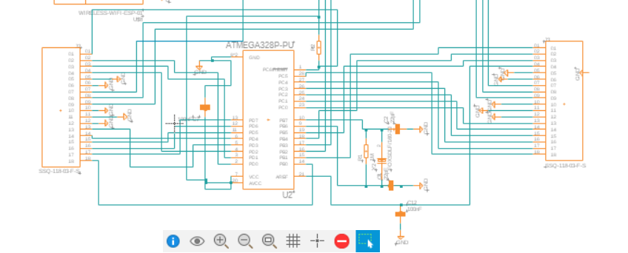

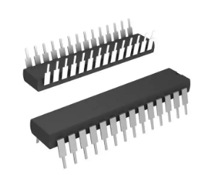
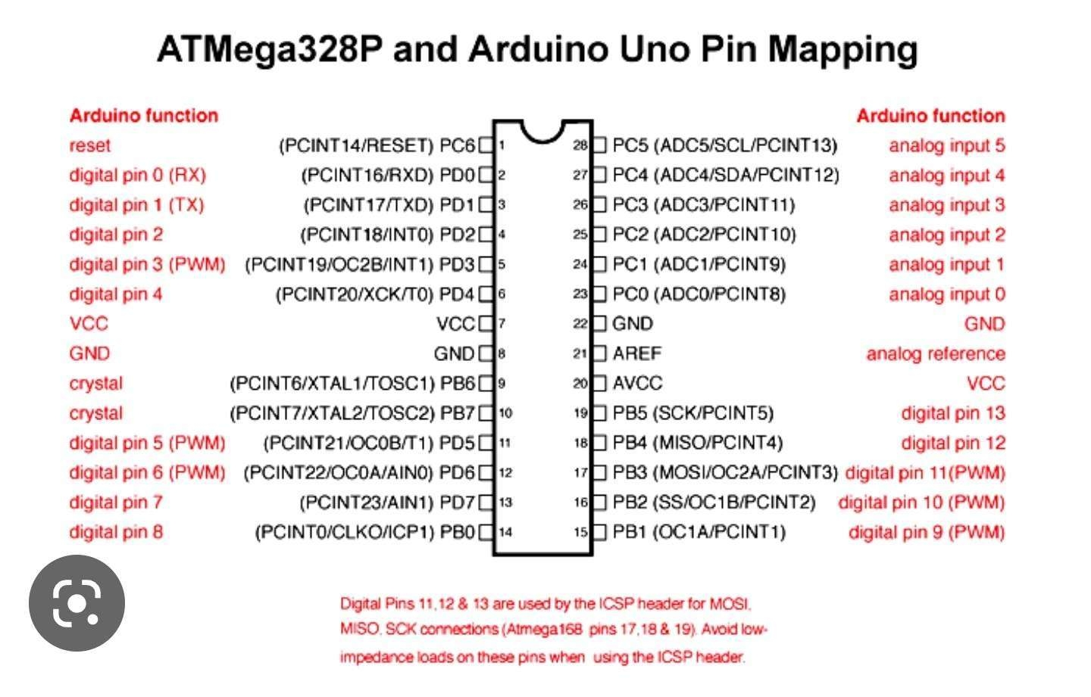
Microcontroller
ATmega328p-pu​
16 MHz external crystal
Operating Voltage:
1.8 - 5.5V
I/O and Packages:
23 Programmable I/O Lines @8MHz
Notes:
For our project, we wanted to capitilize on the vast infrastructure and community that comes with using Arduino compatible prodructs. The ATMega32p-pu, which can be found in the Arduino Uno, offered an affordable and easy to use option. In using the ATMega328p we were able to for-go the need to add a programmer into our schemtaic and electrical design.
Instead we simply used the programmer local to the Arduino Uno, that was bought and used for testing, to upload code to the ATMega328p-pu which was then transferred to our final design.
In addition, due to the fact we wanted our system to be as efficient and accurate as possible, as shown in our schematic, we decided to utilizes an external 16 MHz crystal oscillator for the ATMega328p instead of using its on-board internal 8MHz crystal oscilator

Slide 18
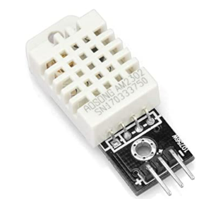
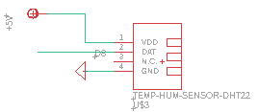
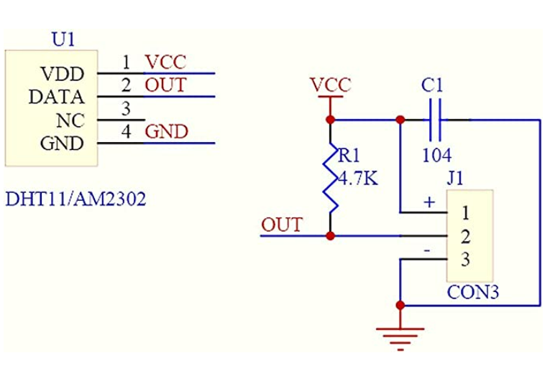
Temperature and Humidity Sensor
DHT22 Temperature and Humidity Sensor
Sampling period: 2 sec
Transmission distance: <= 100m
Operating Voltage: 5V
Operating Current: ~1 - 1.5mA
Stand-by Current: 40-50uA
Notes:
The first of three different types of sensors that we will be using in our project is the DHT22 temperature and humidity sensor. This sensor can measure temperature from -40°C to 80°C and humidity from 0% to 100% with an accuracy of ±0.1°C and ±0.1% humidity and has a transmission distance of up to 100m.
The other main option we discussed was the DHT11. We chose the DHT22 variation over the DHT11 sensor, because despite its slightly higher price and slower sampling time, it offers better resolution and a wider temperature and humidity range than the DHT11.
In addition, the DHT22 sensor was chosen due to its built in breakout board. This breakout board contains the required pull-up resistor and capacitor depicted in the schematic located at the bottom of the screen. The addition of this breakout board helps to reduce unnecessary complexity in our PCB board design.
No external pullup resistor needed – integrated into breakout board – capacitor used for wave filtering
The DHT22 sensor has a better resolution and a wider temperature and humidity measurement range (more expensive than DHT11 and longer sampling time 2 sec vs 1 sec)
Speak on what sensor does and how it works
Speak on placement in final design / range of device / power connection
Possibly talk about DHT11 alternative and why that was not chosen
Single Bus Bidirectional
4 pin sequence number
Temperature range from –40 – 80degrees celcuis
Humidity range from 0-100%

Slide 19
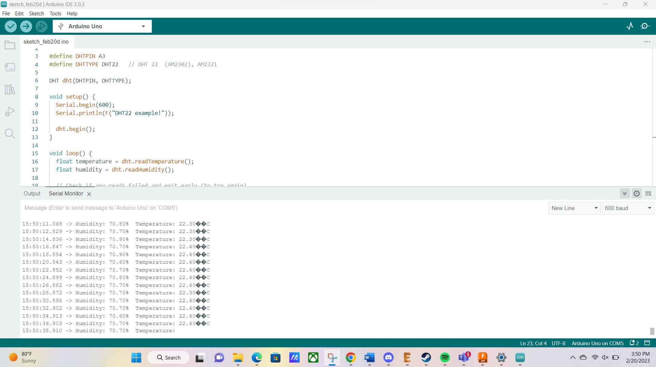
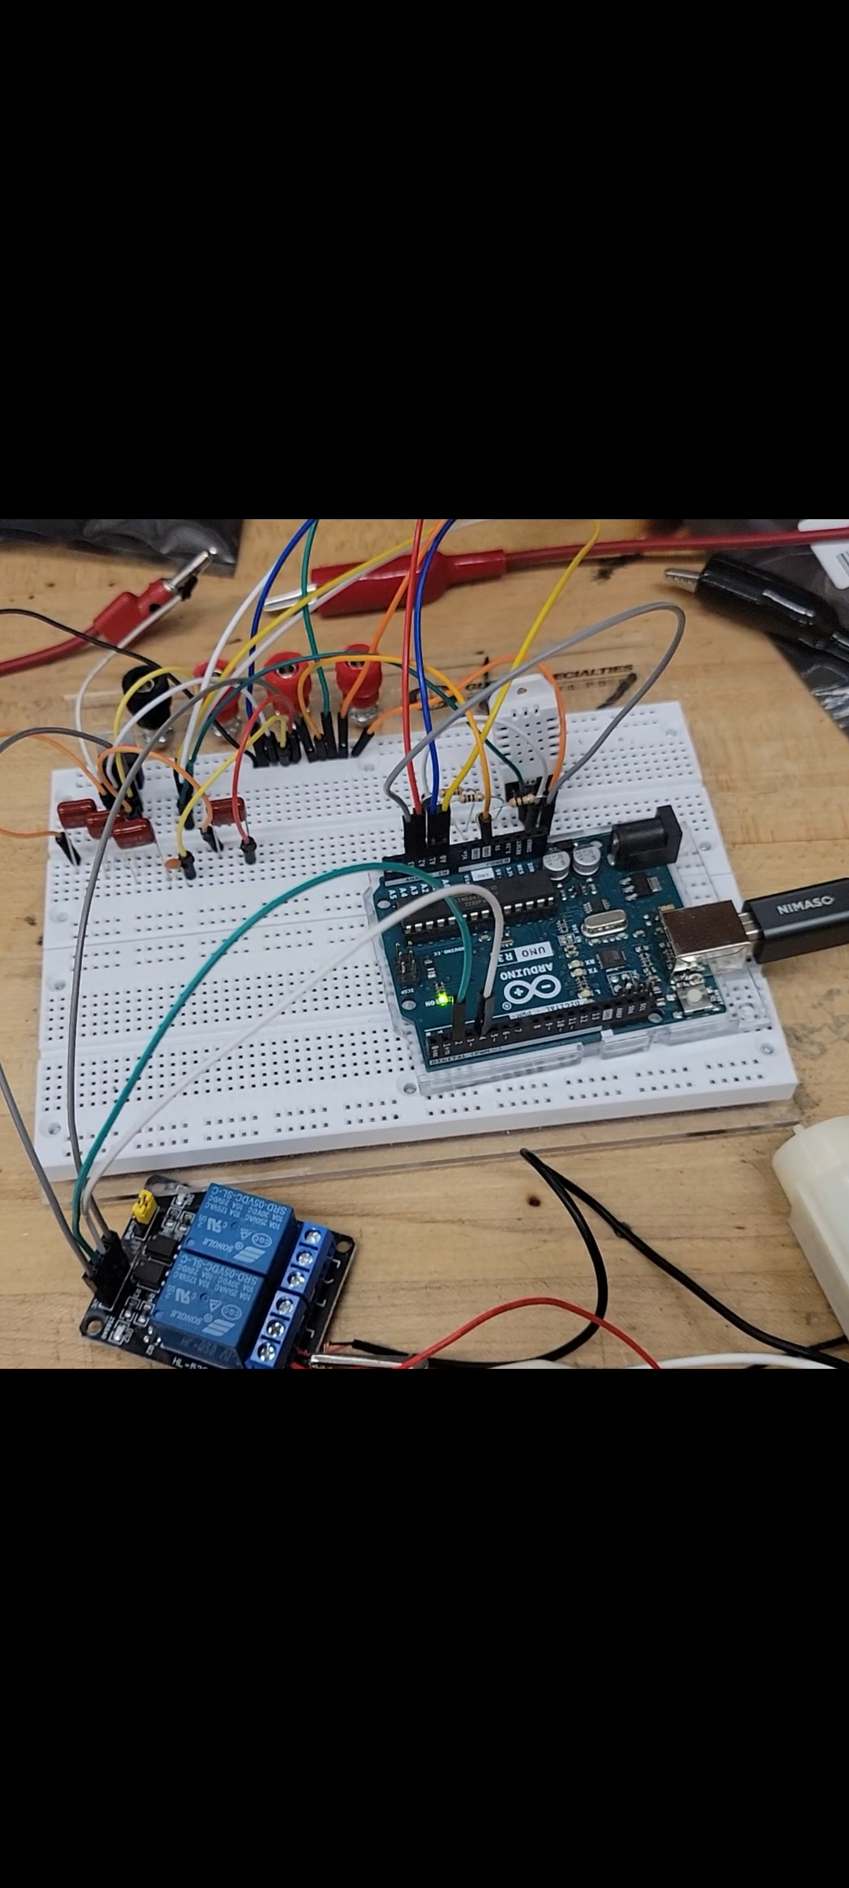
Temperature and Humidity Sensor
Notes:
This is a small insight into our initial hardware testing for our temperature and humidity sensor. Depicted on the right is the output received via our test code which was run using the Arduino IDE software. Slight changes to test code need to be made to get rid of symbols in the output, but overall the reading was successful and outputted correct temperature
Initial Temp Humidity sensor test
Speak on output – Slight changes to test code need to be made for the output but overall reading was successful and outputted correct temperature
(Possibly going to change C to F)

Slide 20
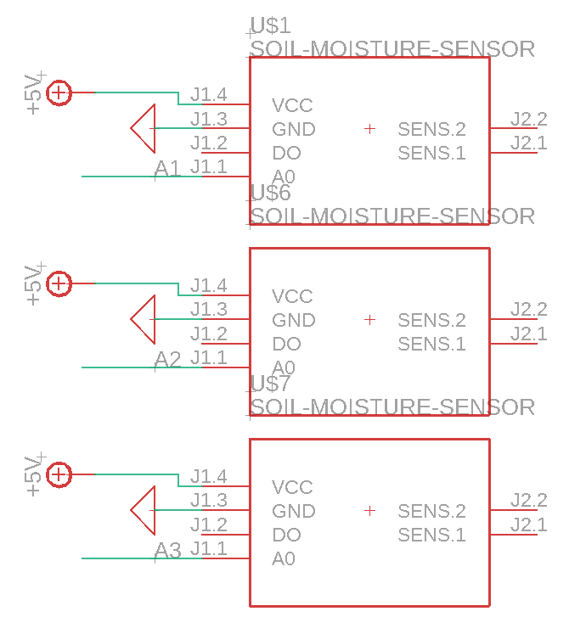
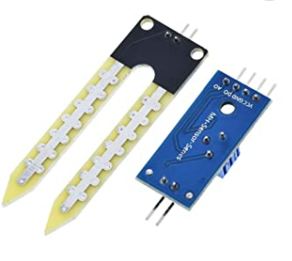
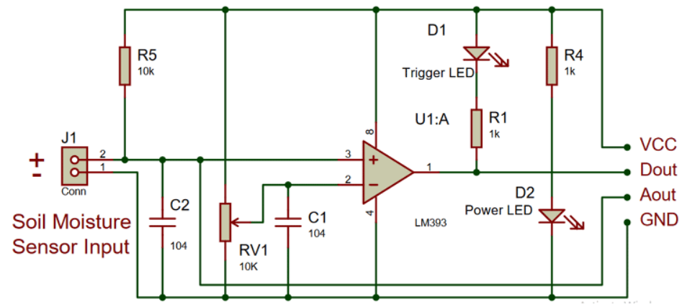
Soil Moisture Sensor
LM393 Soil Moisture Sensor
Adjustable Sensitivity
Module Dual Output
Operating Voltage: 5V
Operating current: <20mA
Notes:
The second sensor that we used in our SMART Garden is the Soil Moisture Sensor.
This sensor consists of a small module containing the LM393 High Precision Comparator and a built-in potentiometer
Included is also a probe which is made of two exposed conductive plates that act as a variable resistor. The resistance of this probe is inversely proportional to the soil moisture of the device. Therefore the more water in the soil, the better the conductivity, and the lower the resistance. Following the same logic, the less the water there is in the soil, the worse the conductivity, and the higher the resistance.
We used three soil moisture sensors in our project. Due to the fact we are growing herbs, which have very shallow root systems, all three probes were placed at the surface level of our garden. This placement resulted in the most accurate readings for our chosen plants. Although, the placement of the sensors is subject to change and can be decided by the user, dependent on the type of plant being grown.
Speak on physical placement of probes in final design / what sensor does and how it works / why this was chosen over more efficient sensor / Connections to power supply
Module Dual output
Adjustable sensitivity
3.3-5V operating range

Slide 21
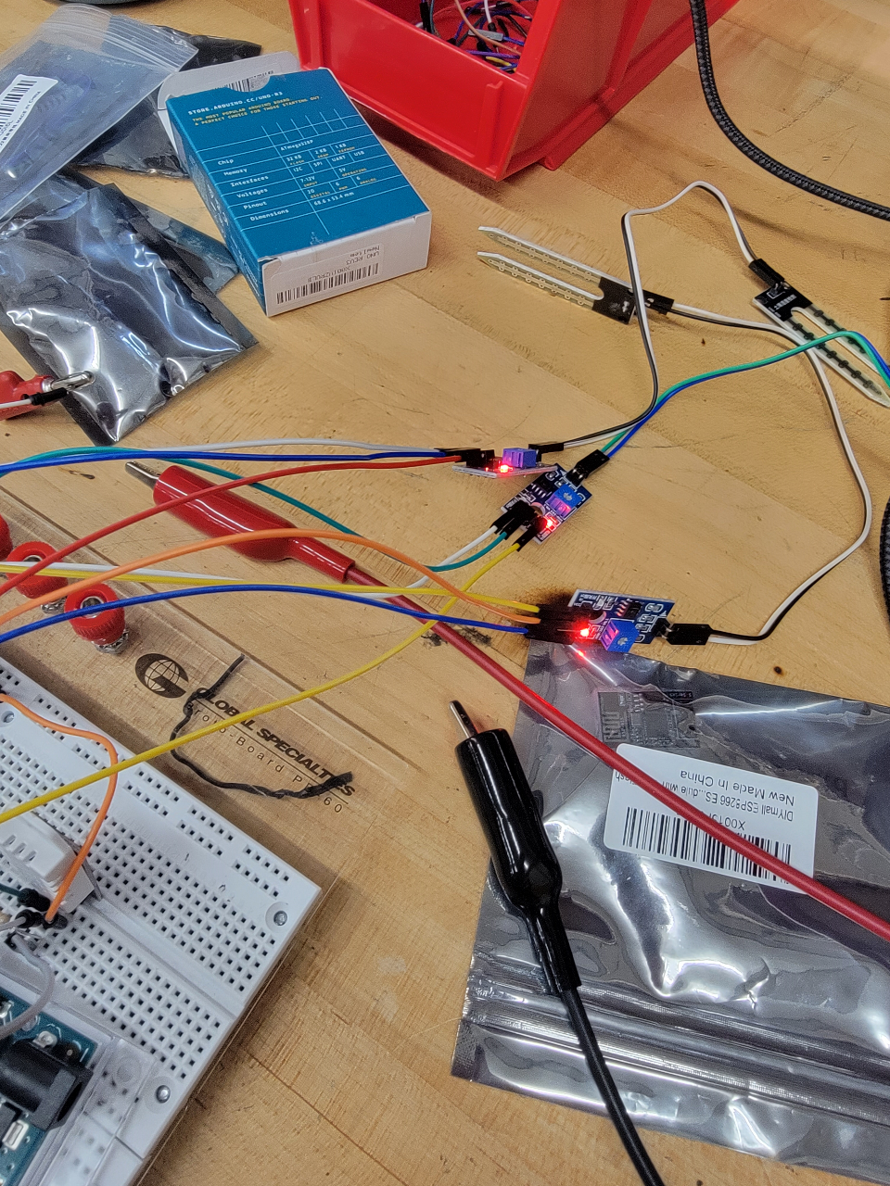
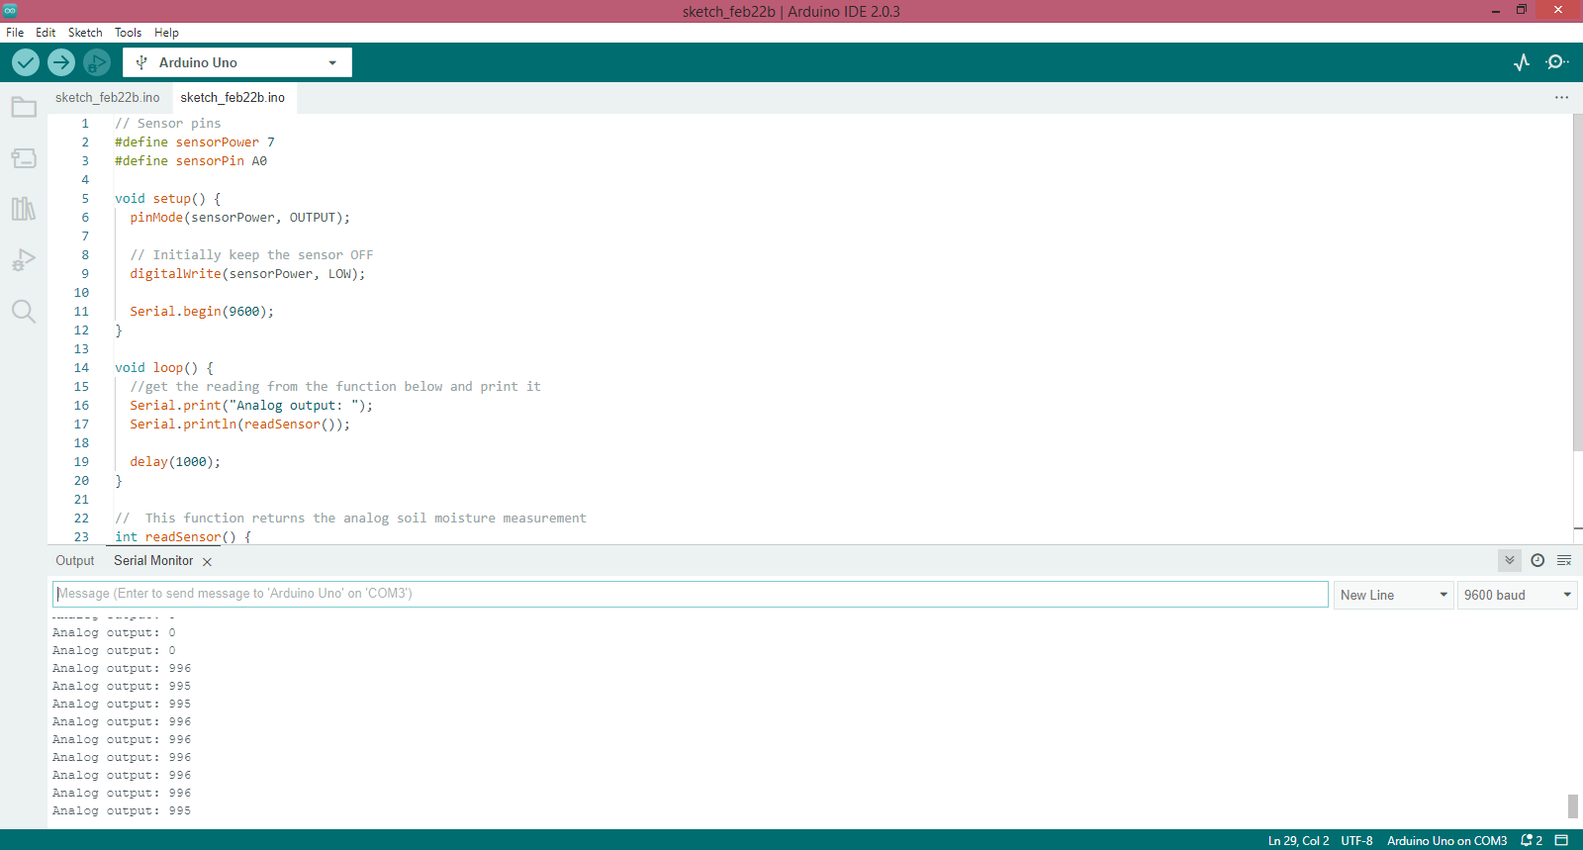
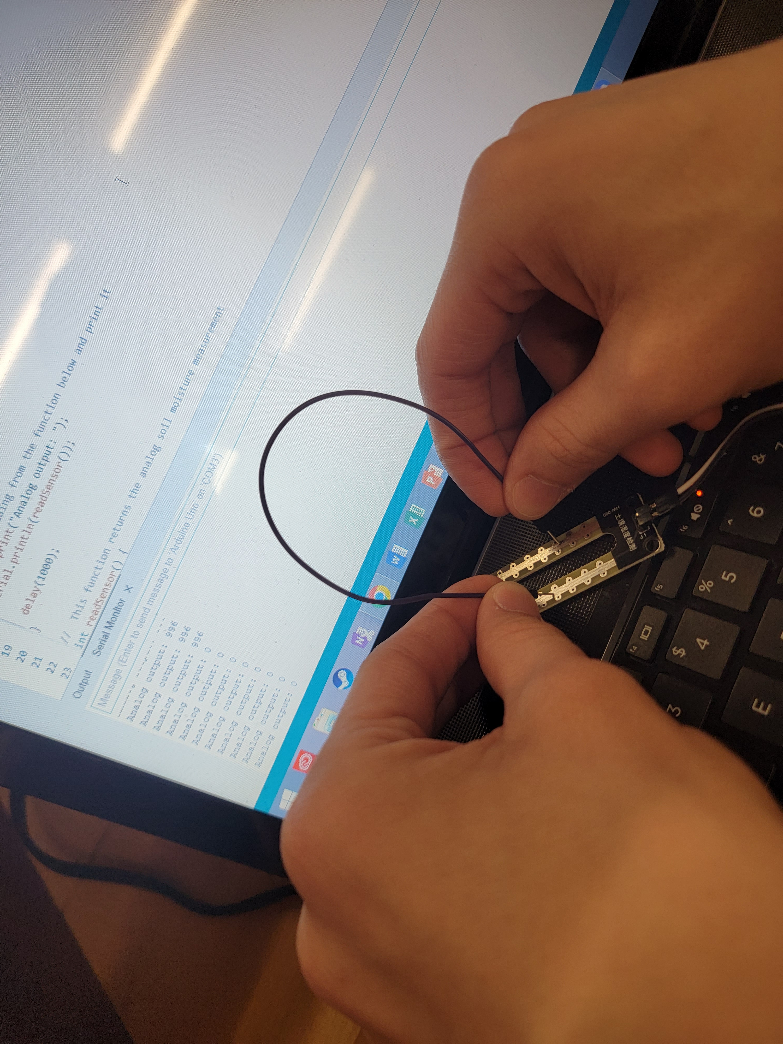
Soil Moisture Sensor
Notes:
Here we have our initial test for our soil moisture sensor. In our tests, and in final application, we will be using the Analog pin on the soil moisture sensor to help prevent corrosion of the device and to provide our user with a more accurate reading. The test reading shown, was successful, the module outputted a value in the upper threshold of the sensors range when there was high resistance, or dry conditions, and outputted an 0 when the sensor was shorted, simulating low resistance, or extremely wet conditions

Slide 22
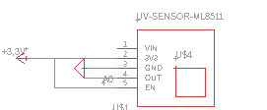
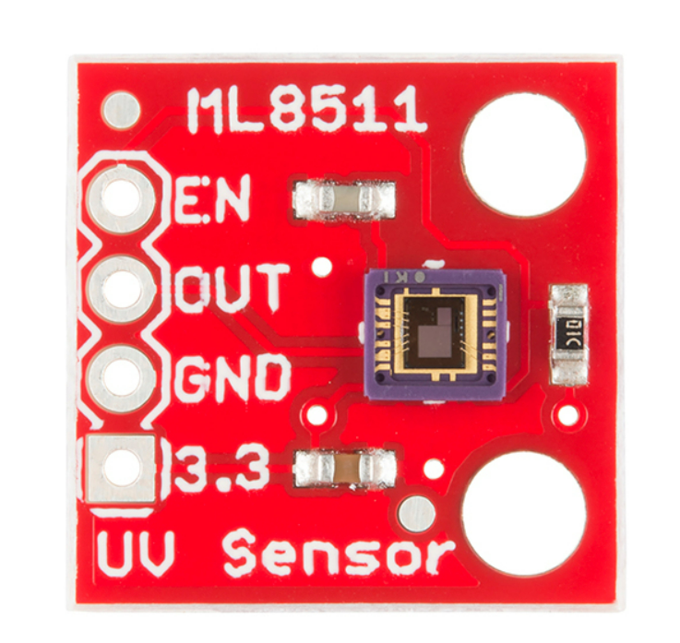
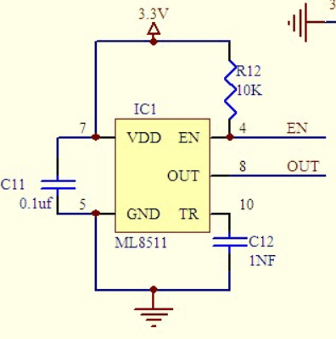

UV Sensor
ML8511 UV Sensor
Operating Voltage: 3.3V
Operating Current (Active): 300uA
Supply Current (Stand-by): 0.1 uA
Notes:
The last of the three sensors we will be utilizing in our project is the ML8511 UV sensor. .
The ML8511 has a Photodiode which detects light in the 280-390nm wavelength. And that range falls within part of the UVB (burning rays) spectrum and most of the UVA (tanning rays) spectrum. In addition to that it has internal Embedded operational amplifier that converts photocurrent to voltage output depending on the UV light intensity. The ML8511 sensor has a low current draw, an operating voltage of 3.3V, and is easy to interface with the Arduino Uno microcontroller. We are waiting on this part to arrive so no testing has been done yet
The purpose of this sensor is to
UV light has many benefits to plant growth. It has been shown to improve the plant’s dry weight, growth potential, and size, increase the rate of photosynthesis AND In some cases, it has been shown to even improve the smell and taste of plants.
Speak on what UV Sensor does and how it works / purpose for component within design/ power connection / don’t read off current draw but state in is low

Slide 23
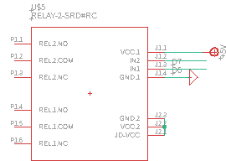

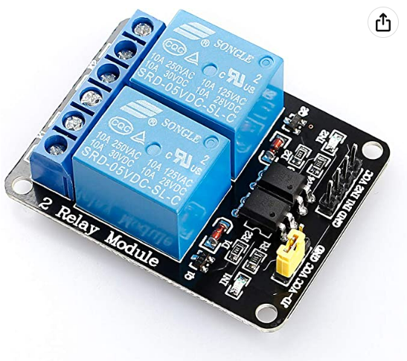
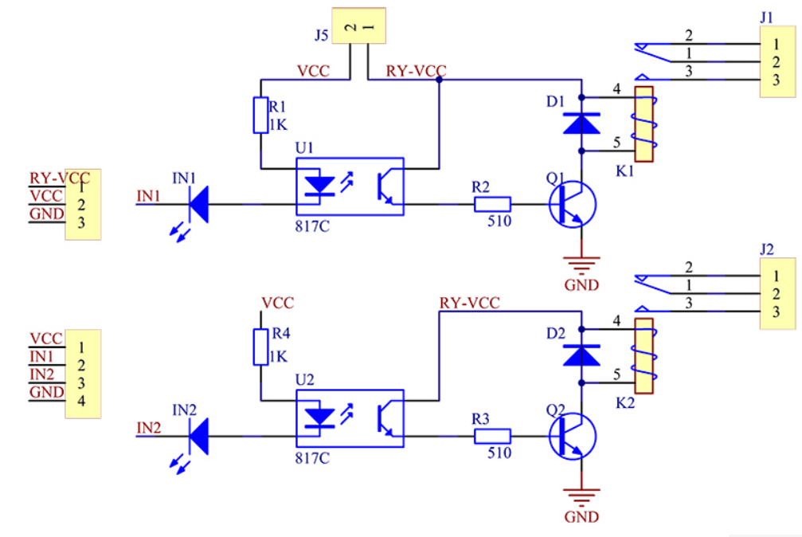
2-Channel Relay
Sunfounder 2-Channel Relay
Operating Voltage: 5V
Trigger Current: 20mA
Relay Coil Current: 70mA per channel
Load Current: 10A max
Response speed: 10ms
Notes:
Our Project requires the use of 2 small 5V water pumps that need to be activated on command in order to achieve the desired automated watering system our project promises. In order to activate these pumps we decided on using the Sunfounder 5V 2-Channel Relay.
This relay has a driver current of about 20mA and draw apporximately 140mA when both relays are acivated. It also comes with built-in octo-couplers on the logic inputs. These octo-couplers offer complete electrical isolation between the logic control input and the relay power and act as an extra layer of protection in the event of a major failure on the relay’s AC load. In addition, another thing that made this relay desirable, is the built in flyback diodes.
These flyback diodes, which are connected in parallel with the relay coils, serve to safely shut down current after the relay coil has been
de-energized.
Speak on Octo-coupler and flyback diode (Reason for choice of component) / power connections/ water pumps being used / Why

Slide 24
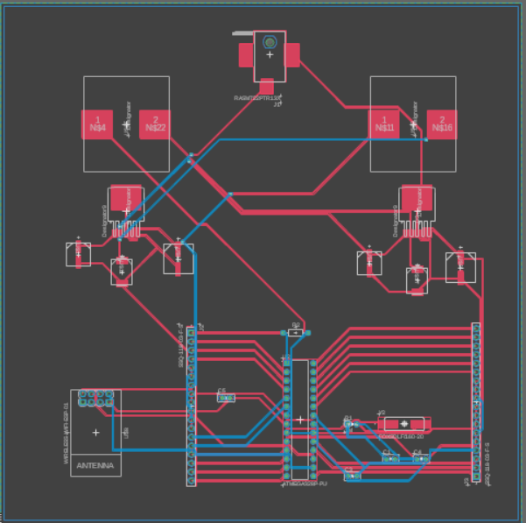
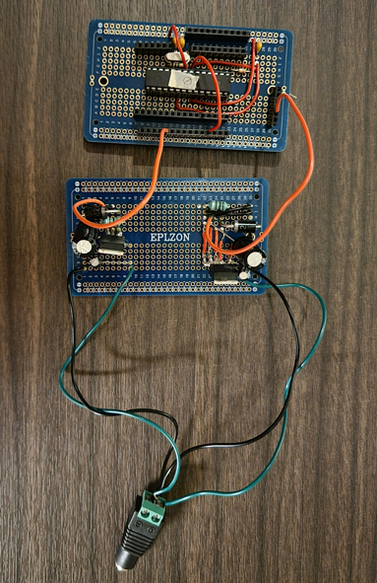
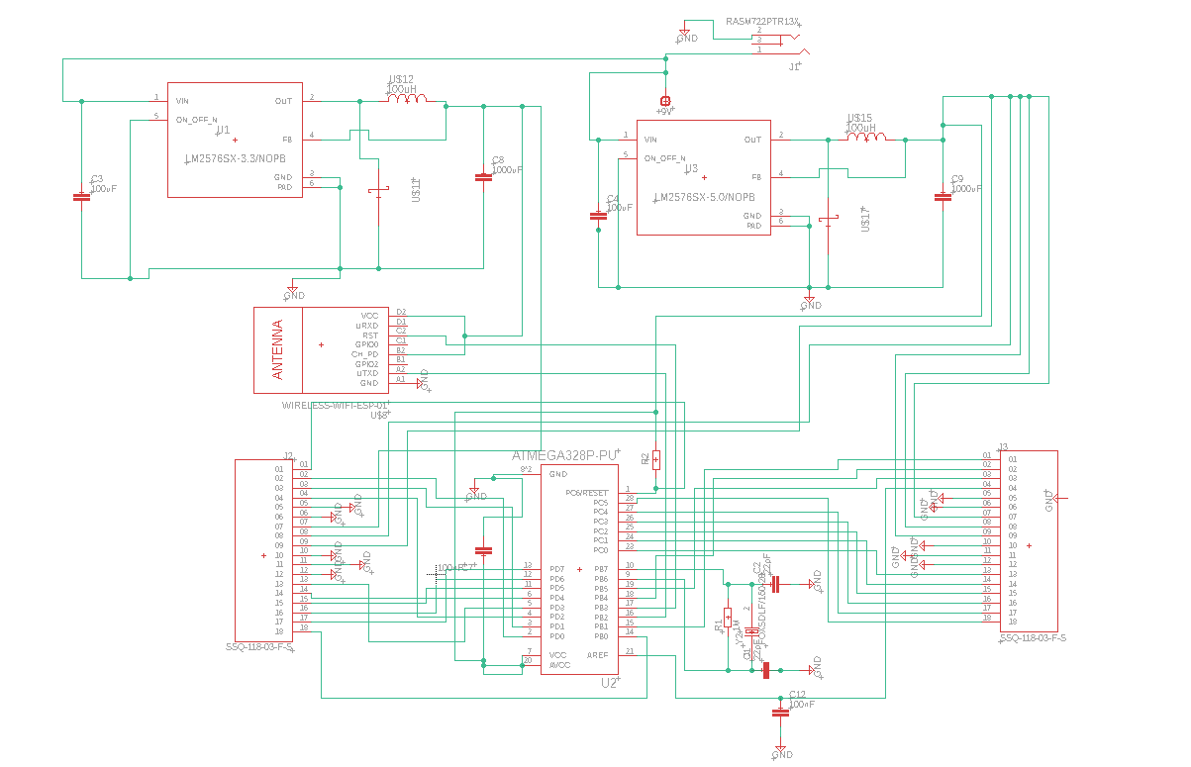

Finalized Schematic and PCB Board Design
Notes:
Here we have our complete schematic. Located at the top of the schematic is the power supply circuit previously discussed. In the center, is our ATMega 328p microcontroller, in addition to our 16Mhz crystal oscilator.
Located on the left and right of the schematic are two 18 socket pin headers, which were placed to externally wire all four of our sensors as well as our 5V 2-channel relay. Our wifi module was set to be mounted and soldered on-borad our pcb.
In the middle of the screen is our finalized PCB board design. Unfortunately, due to time constraints we were not able to get the PCB board in on time.
Although, as can be seen on the far right side of the screen, the equivalent circuit was soldered using two development boards. Our AC/DC input channel was created using a male power jack.
This power jack is directly connected to our first development board which contains both the 3.3V and 5V LM2576 voltage regulator circuits, which are grounded to the supply voltage on the power jack.
The voltage regulator circuits are then connected directly to our 2nd development board, and serve to power all auxilary components for our design
to include, the esp8266 Wi-fi module, 3 soil moisture sensors, one temperature and humidity sensor, one 2-channel relay, and the ATMEGA328p microcontroller.
As desired in the original PCB board design, our development board comes equipped with pin headers which our wired to each individual pin on the ATMEGA, as well as multiple pins designated for 3.3V inputs, 5V inputs, and GND.
This board offered the same functionality as expected from our custom PCB board design and was found to be an efficient alternative to a manufactured PCB

Slide 25
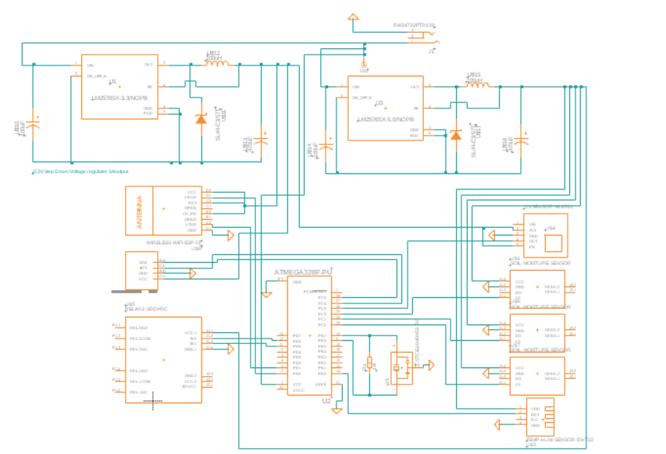
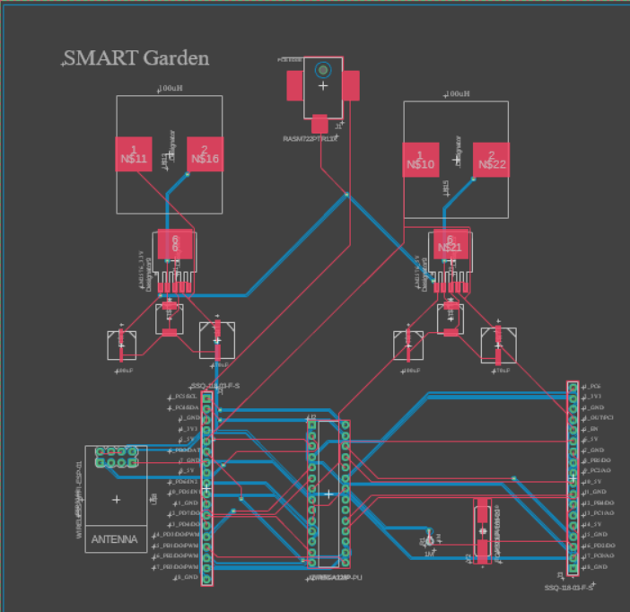
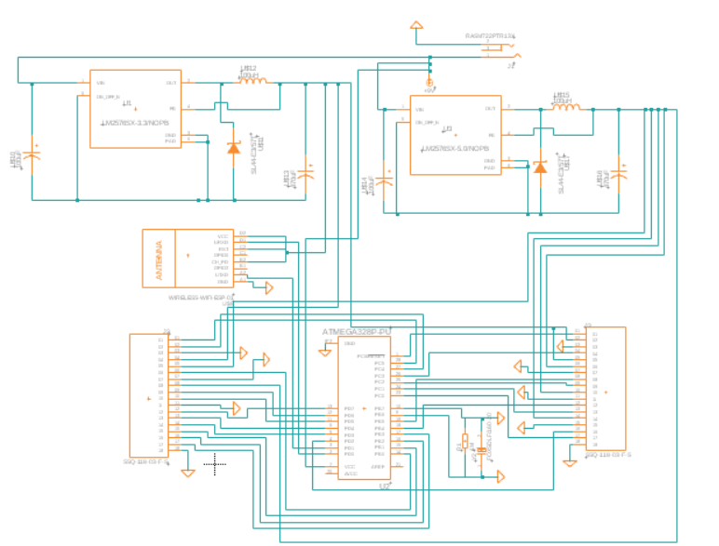
Original Schematic and PCB Board Design
Notes:
Here we have the progression of our schematic and PCB board design. I'd like to use this time to walk you through the issues we encountered with our original designs and how we went about changing them.
If you look to the far left of you screen you will see our first iteration of our schematic design. Our original thought was to have all components mounted directly to the pcb board. Although, after discusion we decided, due to the fact that most of our componenet are sensors, or need to be located close to specific parts of our physical build, that we would add pin headers to the board instead and route all necessary components externally
For both our initial schematic and our secondary schematic we had issues with the set-up of the ATMega328p. We failed to add the the pull-up resistor on the reset pin, failed to add bypass capacitors on our external 16Mhz crystal, and left out multiple decoupling capacitors, that were needed on both VCC and GND, to smooth out noise from the power supply and other active components.
In addition to that, a simple and careless mistake was made and our voltage regulator circuits were not properly grounded
As a result, our first PCB, which was ordered from JLCPCB, ended up containing substantial issues. Multiple days were dedicated to problem solving, and while all issues with the board were discovered, there were too many to fully fix that iteration of our pcb board design.
Once this was discovered, a new pcb board design was created, but there was not enough time before final demonstration for it to be ordered and shipped.
As a result of this, the equivalent circuit was created and soldered using pcb development boards. Once completed our new pcb was integrated into our final project demonstration, and offered the same functionality as expected from our orignal custom pcb board desgin

Slide 26
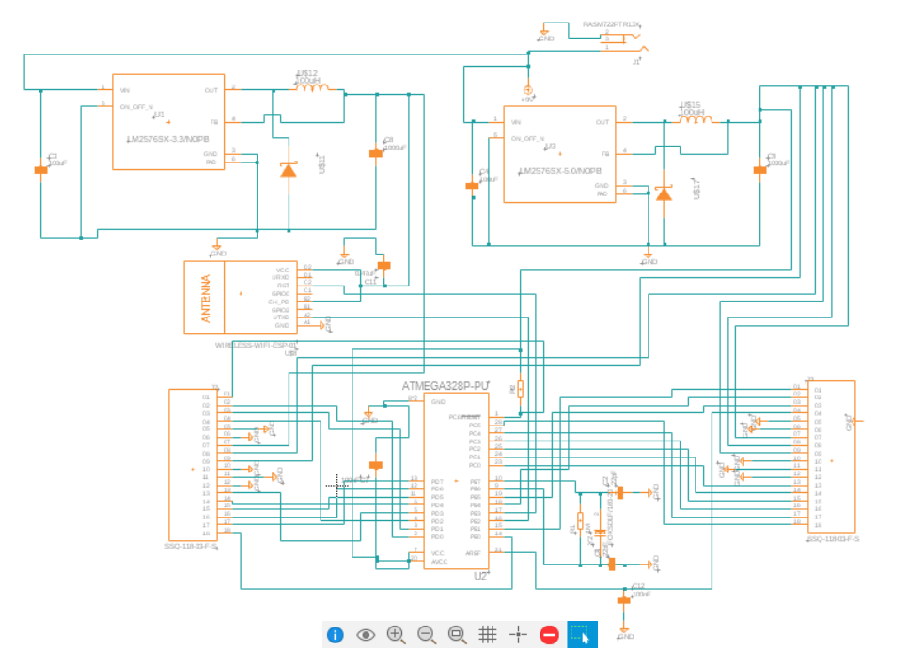
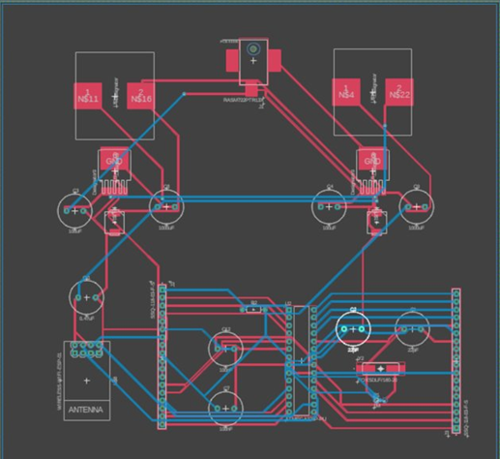
Known limitations/current problems?

Slide 27
Kevin’s Section
I am assuming we can/will move these around to where they will fit better.

Slide 28
Kevin’s report topics for contribution ideas
Batteries. voltage, why use rechargeable. Lithium-Ion
Talk about why it’s the size it is. While designed with indoors in mind, outside could be viable?
Why use wif-fi over BT –better range, better power, better security, non-prohibitive data limits.
Standards used – Arduino IDE standards obviously required (e.g. digitalWrite( #, High/low/etc?)), Database Wi-Fi standards?
Software used list. Arduino IDE, LAMP stack(did someone else write about this?), Github

Slide 29

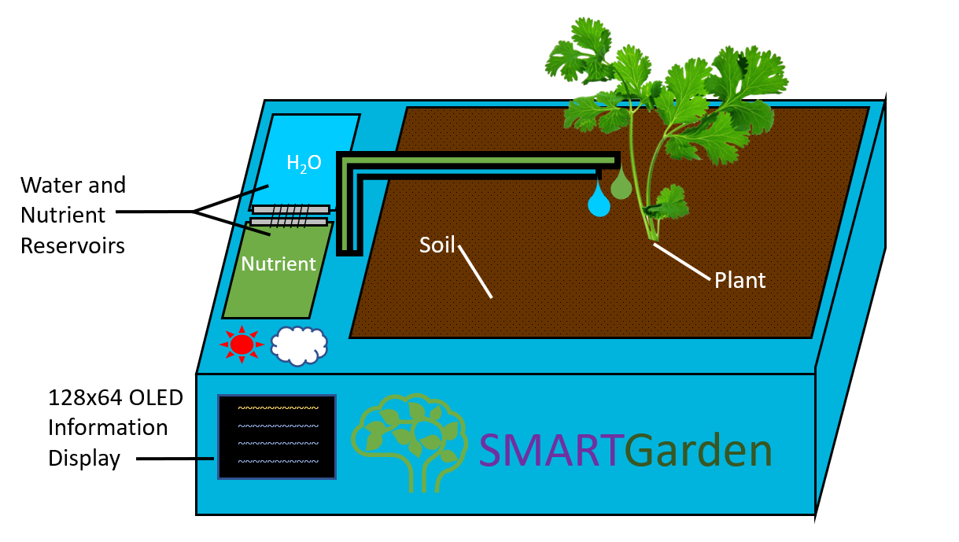
Design – Side View
Notes:
This is our initial rendition of what the SMART Garden would look like if designed as a product sold in stores. Though we did change it quite a bit, the general layout remained the same.
This side view lets us see the informational display and the closed panels for the water reservoir and the nutrient reservoir, as well as what the garden will look like while it is in use.

Slide 30
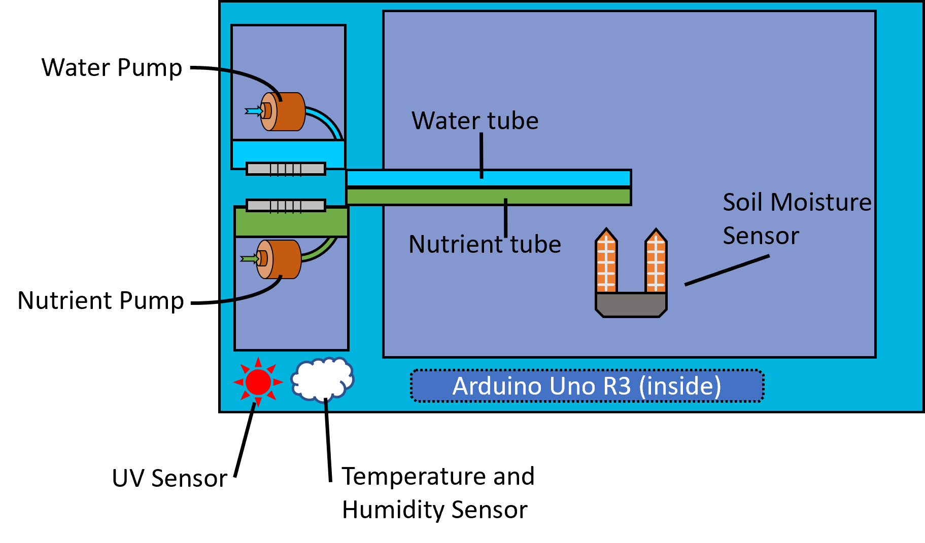
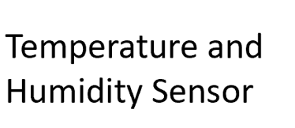
Design – Top View
Notes:
The top view diagram labels many of the smaller parts. You can see the individual pumps for the water and nutrient reservoirs as well as the tubes that take each one to the plant itself.
Under where the soil was we can now see a model of the soil moisture sensor, though we actually take an average of multiple sensors to get a more representative reading of the entire garden.
Above where the display would have been, we can see the location of the temperature and humidity sensor.
Behind the logo is where we had planned to mount the Arduino Uno R3. This placement is so that it is relatively close to all of the other devices involved in the garden without messy and overlapping wires.
(I made this quite early in the design process, and hadn’t considered the use of a PCB yet, though the placement would be similar.)

Slide 31
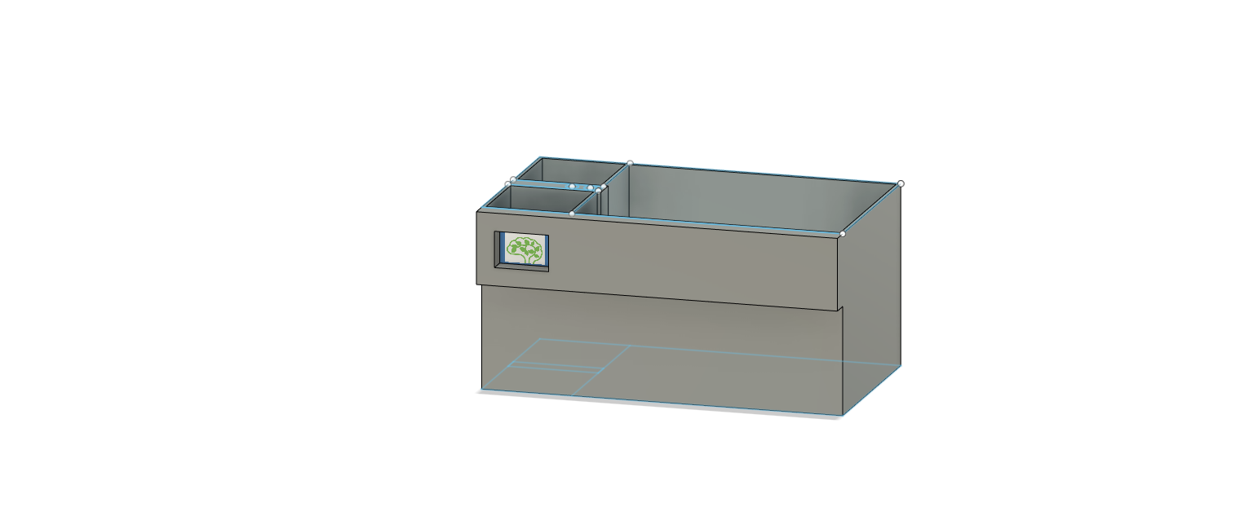
Design – Initial Mock up
!old audio
Notes:
Model Made by Lauren
This is roughly what our prototype container for the garden looks like. This version is deeper to accommodate a larger supply of water and nutrients, as well as any plants with more restrictive requirements for growing space.

Slide 32

Design Justification
!old audio
This initial design we made out of wood is about 12 inches wide and deep, and about 18 inches long.
This is large enough to accommodate a large variety of plant species without taking up an inconvenient amount of space in the home.
The depth of the container allows plenty of space for root growth.
The area allows for a few specimens to be grown at once, provided the rest of their needs can be met. Some types of plants need more space than others.
Notes:
Slide sequence-
Idealized design 1 and 2
Current mockup
This slide

Slide 33
Power Source
A 9V AC to DC converter provides enough voltage to power the Arduino Uno, which has an operating range of 6-20 volts, with an optimal range of 7-12 volts.
The option of batteries was considered, but the final design of the garden assumed that it would be used indoors. Replacing batteries was determined too costly and high maintenance.
A constant power supply ensures that there will be no downtime when caring for the plant, allowing it to have optimal growth conditions at all times.
Notes:
FINAL: Just read the thing?
B2: Since the SMART Garden is geared toward being convenient and accessible, being able to recharge the batteries instead of using another set of disposable batteries means fewer trips to the store as well.
B3: Longer battery life means you can be gone for longer while being ensured that your garden will be taken care of.
B3 source: https://www.microbattery.com/blog/post/battery-bios:-everything-you-need-to-know-about-the-9v-battery/

Slide 34
Standards Used
We did our best to design the PCB following as many standards as we could regarding components and layout.
Since we transmit data via Wi-Fi, we must following the IEEE 802.11 standards of Wi-Fi communication.
In programming within the Arduino IDE we followed some standards for the hybrid C/C++ language used, as well as some self-determined standards regarding code layout and naming conventions.
Notes:
FINAL:naming conventions such as- variable names must be clear about what they represent.
Updated to not be extremely long:
B1: We have placed our components where they will be easily accessible and won’t be too crowded, and have included protections, such as flyback diodes, for sensitive components where necessary.
B2: this is a basic set of standards for wireless communication using Wi-Fi brand communication technology
B3: ,though these may overlap with some of the standards for programming other microcontrollers.
Additionally, we will have to follow any agreed-upon standards of variable-naming, such as using camelCase for all variables.
Old:
B1: We have placed our components where they will be easily accessible and won’t be too crowded. Though we are still finalizing the design,
we have thus far avoided any sharp corners on the copper layout, and have included protections for sensitive components where necessary such as flyback diodes.
B2: IEEE 802.11 provides a basic set of standards for wireless communication using Wi-Fi brand communication technology, [though there are other versions with additional suffixes like 802.11ac or 802.11be]
B3: The Arduino IDE has some unique functions separate from other microcontrollers, even if they sometimes have methods with similar effects. For example, pinMode(), and digitalWrite()
Additionally, we will have to follow any agreed-upon standards of variable-naming, such as using camelCase for all variables.

Slide 35
Software Used
The Arduino IDE was used to create the program (known as a ‘sketch’) that was uploaded to the ATMEGA328P for the actual function of the garden.
Our main method of discussing tasks and scheduling meetings was to use a Discord server.
Github was used to allow the entire group to collaborate on code for the Arduino and the web component.
We implemented a LAMP stack onto a web-based database that the garden retrieves data from and sends sensor readings to.
Notes:
Intro: Many different programs and software are used in this project
B1: It was also used to download relevant libraries, compile the sketch and upload it onto the Arduino Uno.
B2: In addition to basic communication, we also kept track of helpful resources and data.
B3: It was also useful when errors occurred to return to a point we knew was functional.
B4: We will be storing the data about each plant type on the web database rather than within the ATMEGA’s code, since the Wi-Fi module is our only method of communicating with the ATEMGA once it is ‘active’.

Slide 36
User interface
The user will select the needs of their plant by connecting the garden to Wi-Fi and using our website to select the ideal conditions for their plant of choice.
Select by plant name from a list or input custom data.
The website will provide the data from the sensors on the project so that the user can see how the SMART Garden is caring for the plant.
Notes:
A: The user will select the needs of their plant by connecting the garden to Wi-Fi and using our website to select the ideal conditions for their plant of choice.
B: We have a list of preset plants, but also allow for the entry of custom values if these options are insufficient.
C: Updating every 15 seconds, the webpage provides the most recent data available from the database to ensure you are aware of any changes.

Slide 37

Wireless Communication Method
Method | Data Rate | Range | Power Consumption | Security
Wi-Fi | ~23-190 Mb/s (8Mb/s Arduino Uno) | 20 m | 0.01 - 100 mW | Key-matching
Bluetooth | ~24 Mb/s (8Mb/s Arduino Uno) | 10 m | 40 – 100 mW | WPA3 / WEP
The data transfer rate is not an obstacle since our project doesn’t require transferring large files or a huge quantity of data.
Wi-Fi’s higher range means fewer limitations on where the garden can be placed.
Lower possible power consumption means the battery can last longer than if Bluetooth were used.
Wi-Fi is more secure than Bluetooth and products must be officially certified to be allowed to claim they are “Wi-Fi CERTIFIED”
Our final choice was to use Wi-Fi.
Notes:
Feasible data rate is based on Arduino Uno clock speed, so this is the maximum theoretical data rate we can get in or out.
We prioritized battery duration, range, and security so that we can reduce the amount of stress and limitations on the user.

Slide 38
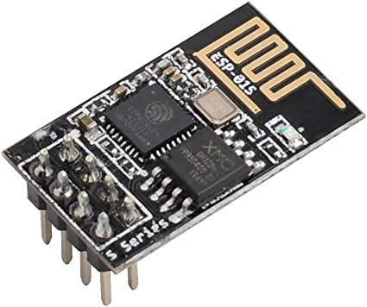
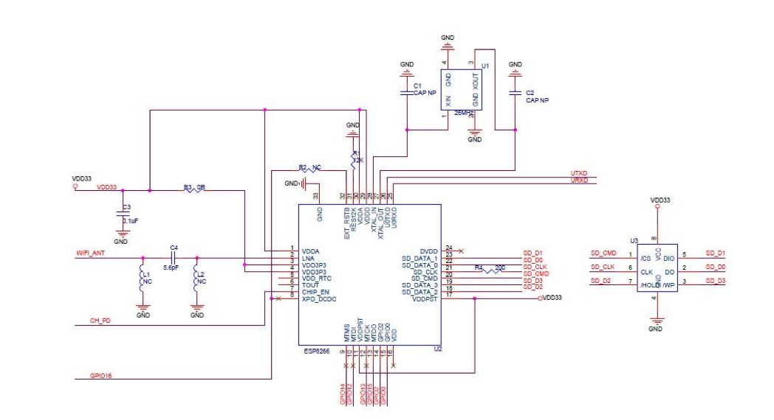
WiFi Serial Transceiver
ESP8266 ESP-01S WiFi Serial Transceiver Module
Built-in TCP/IP
4MB of Flash Memory
3.3V operating voltage
Standby power consumption < 1mW

Slide 40
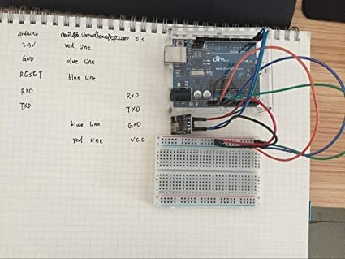
WiFi Serial Transceiver

Slide 41
GANTT SLIDE HERE
optional

Slide 42
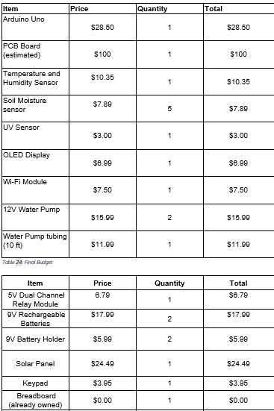

Budget

Slide 43

Soil Moisture Level Equation

Slide 44

Future Works
Mobile Application
Solar Array
Battery Powered

Slide 45
Conclusion

